Slide 1
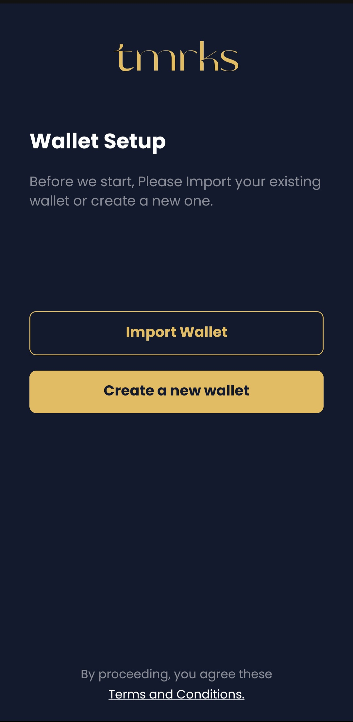
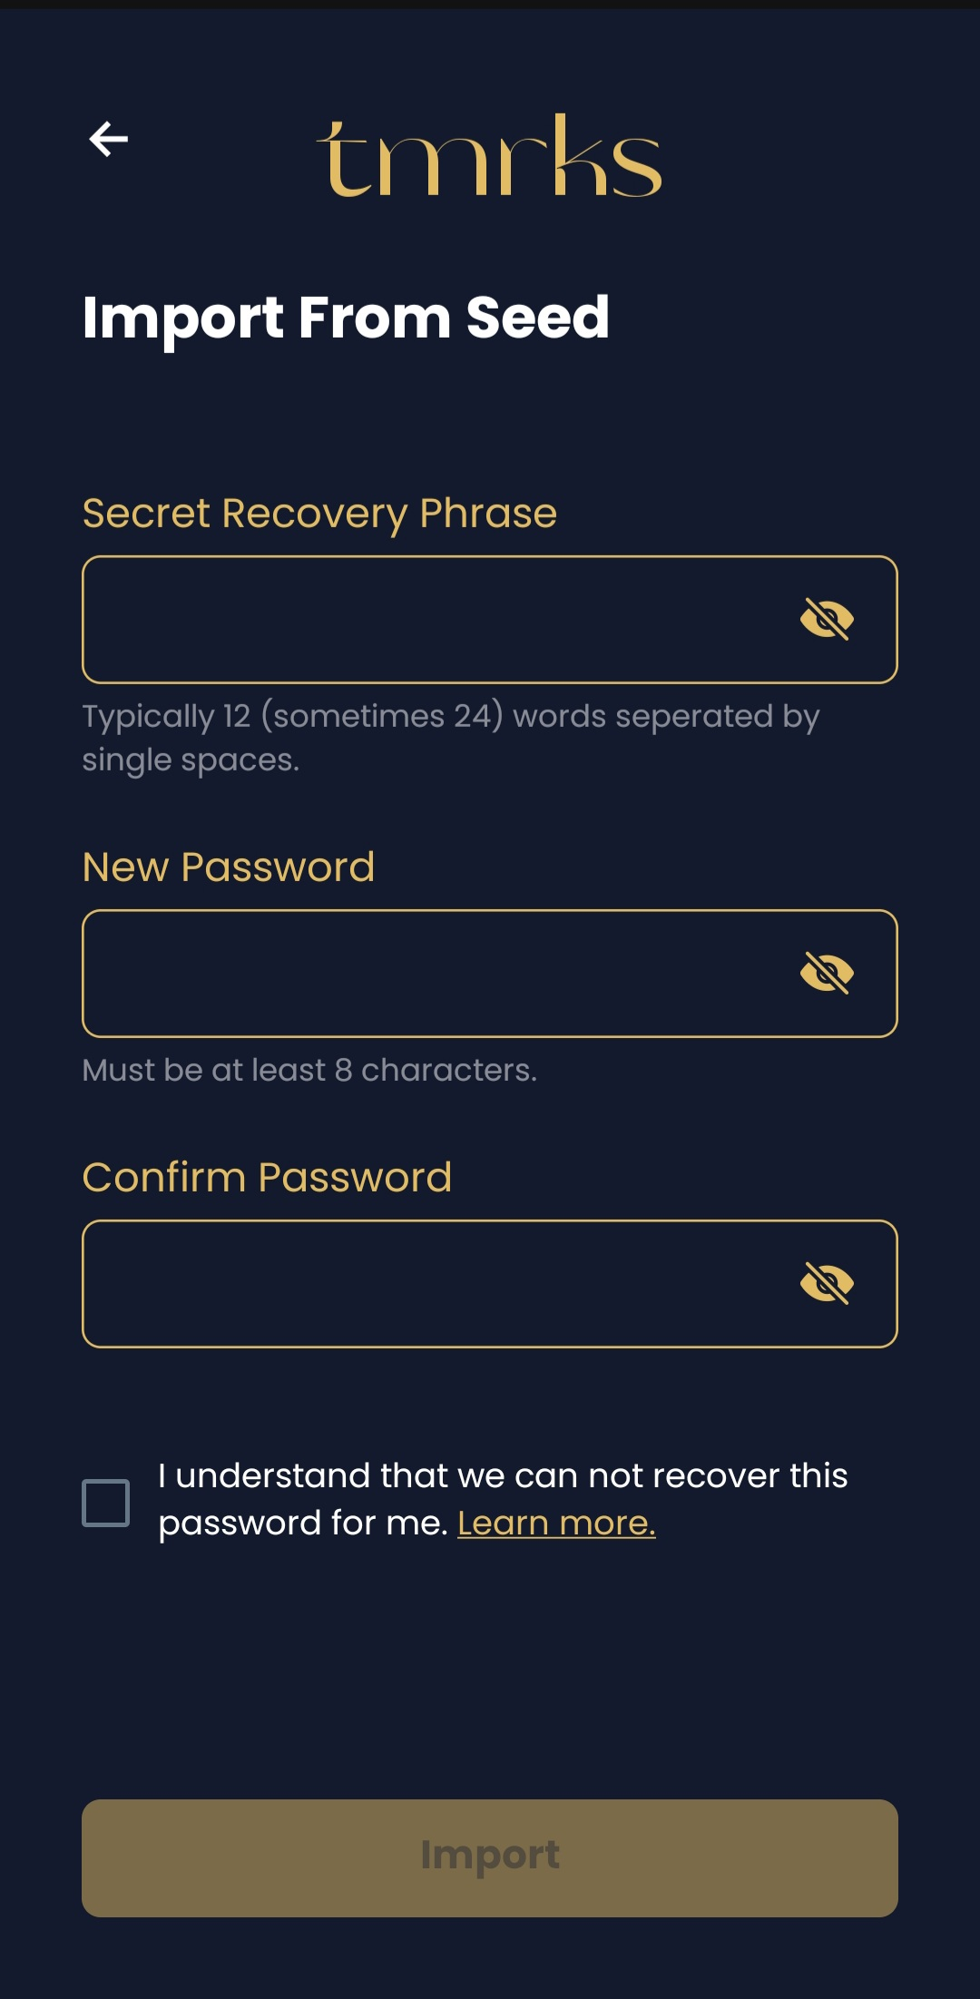
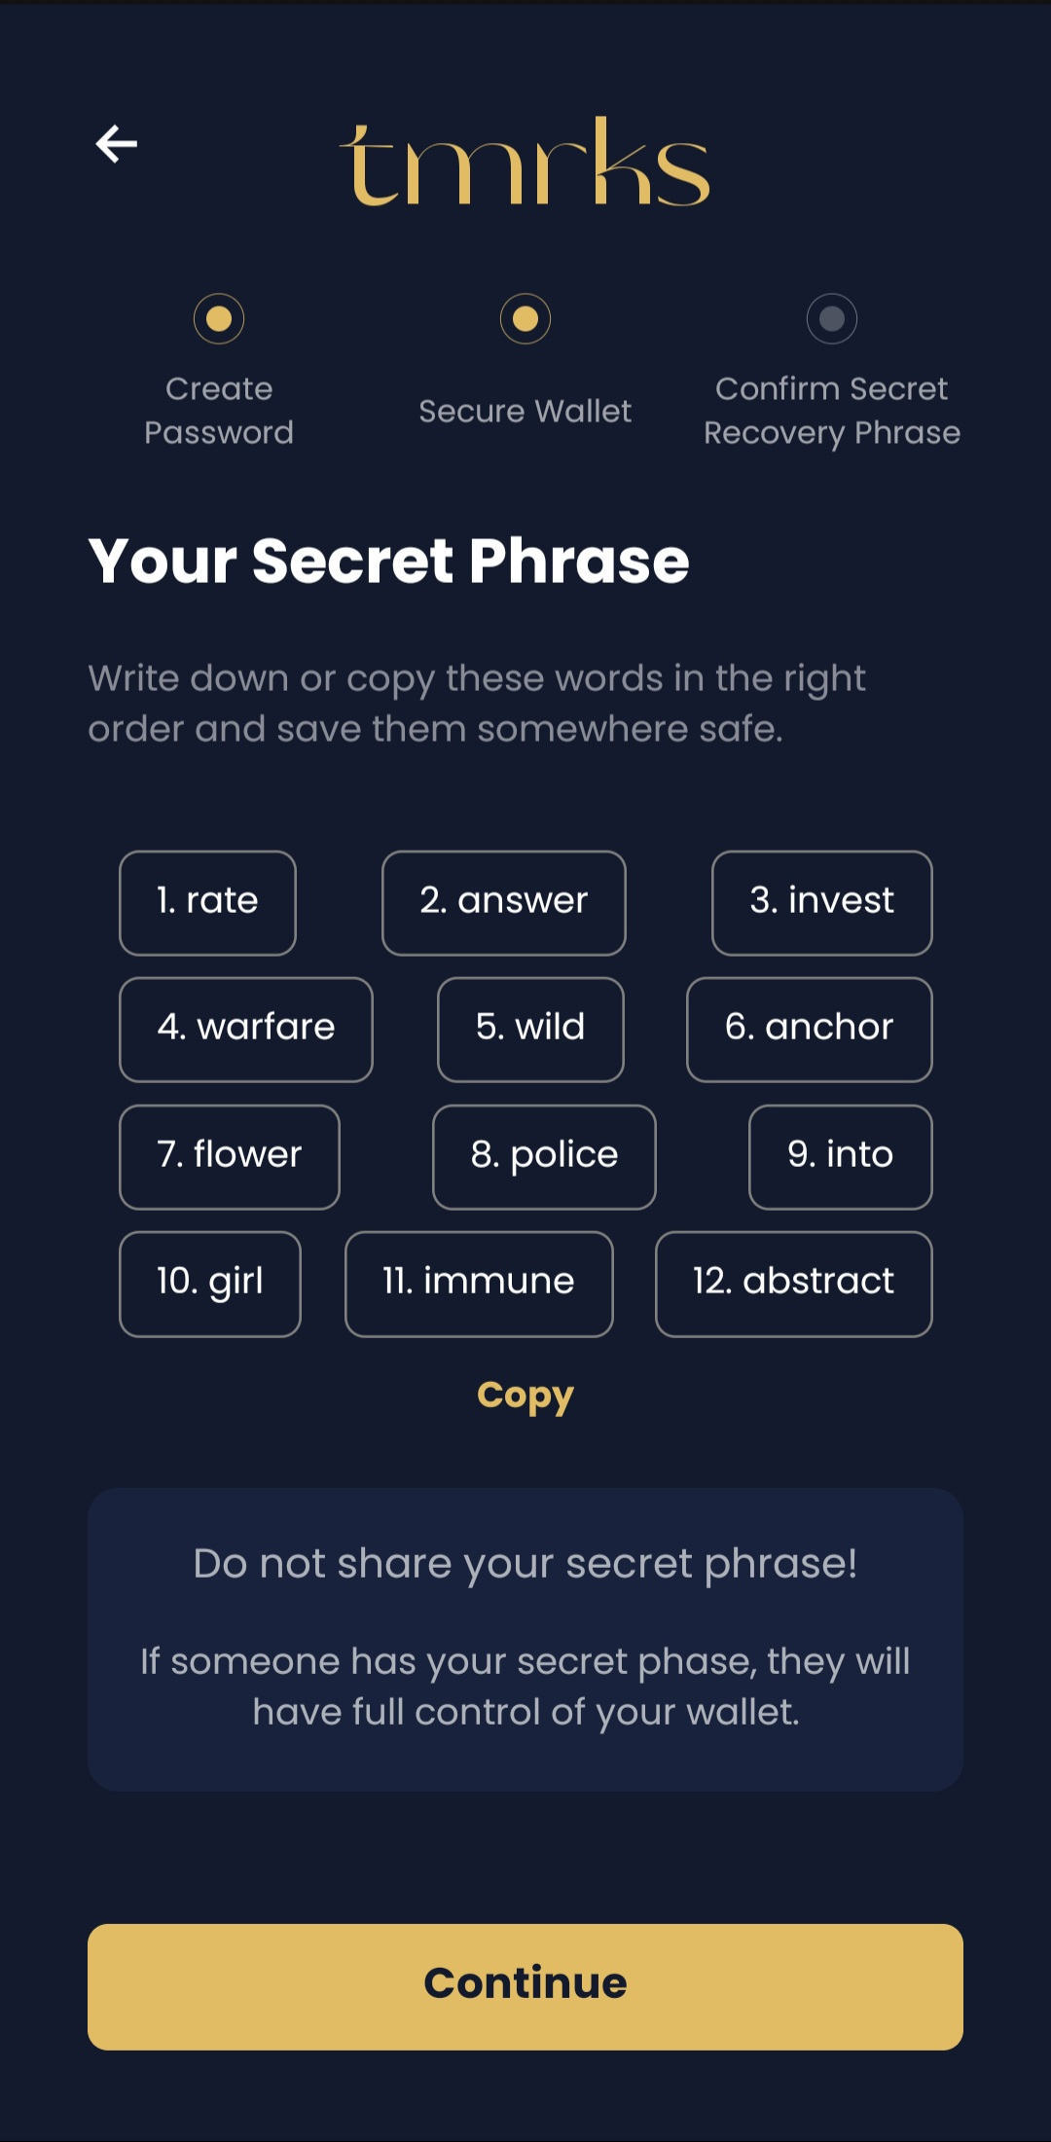
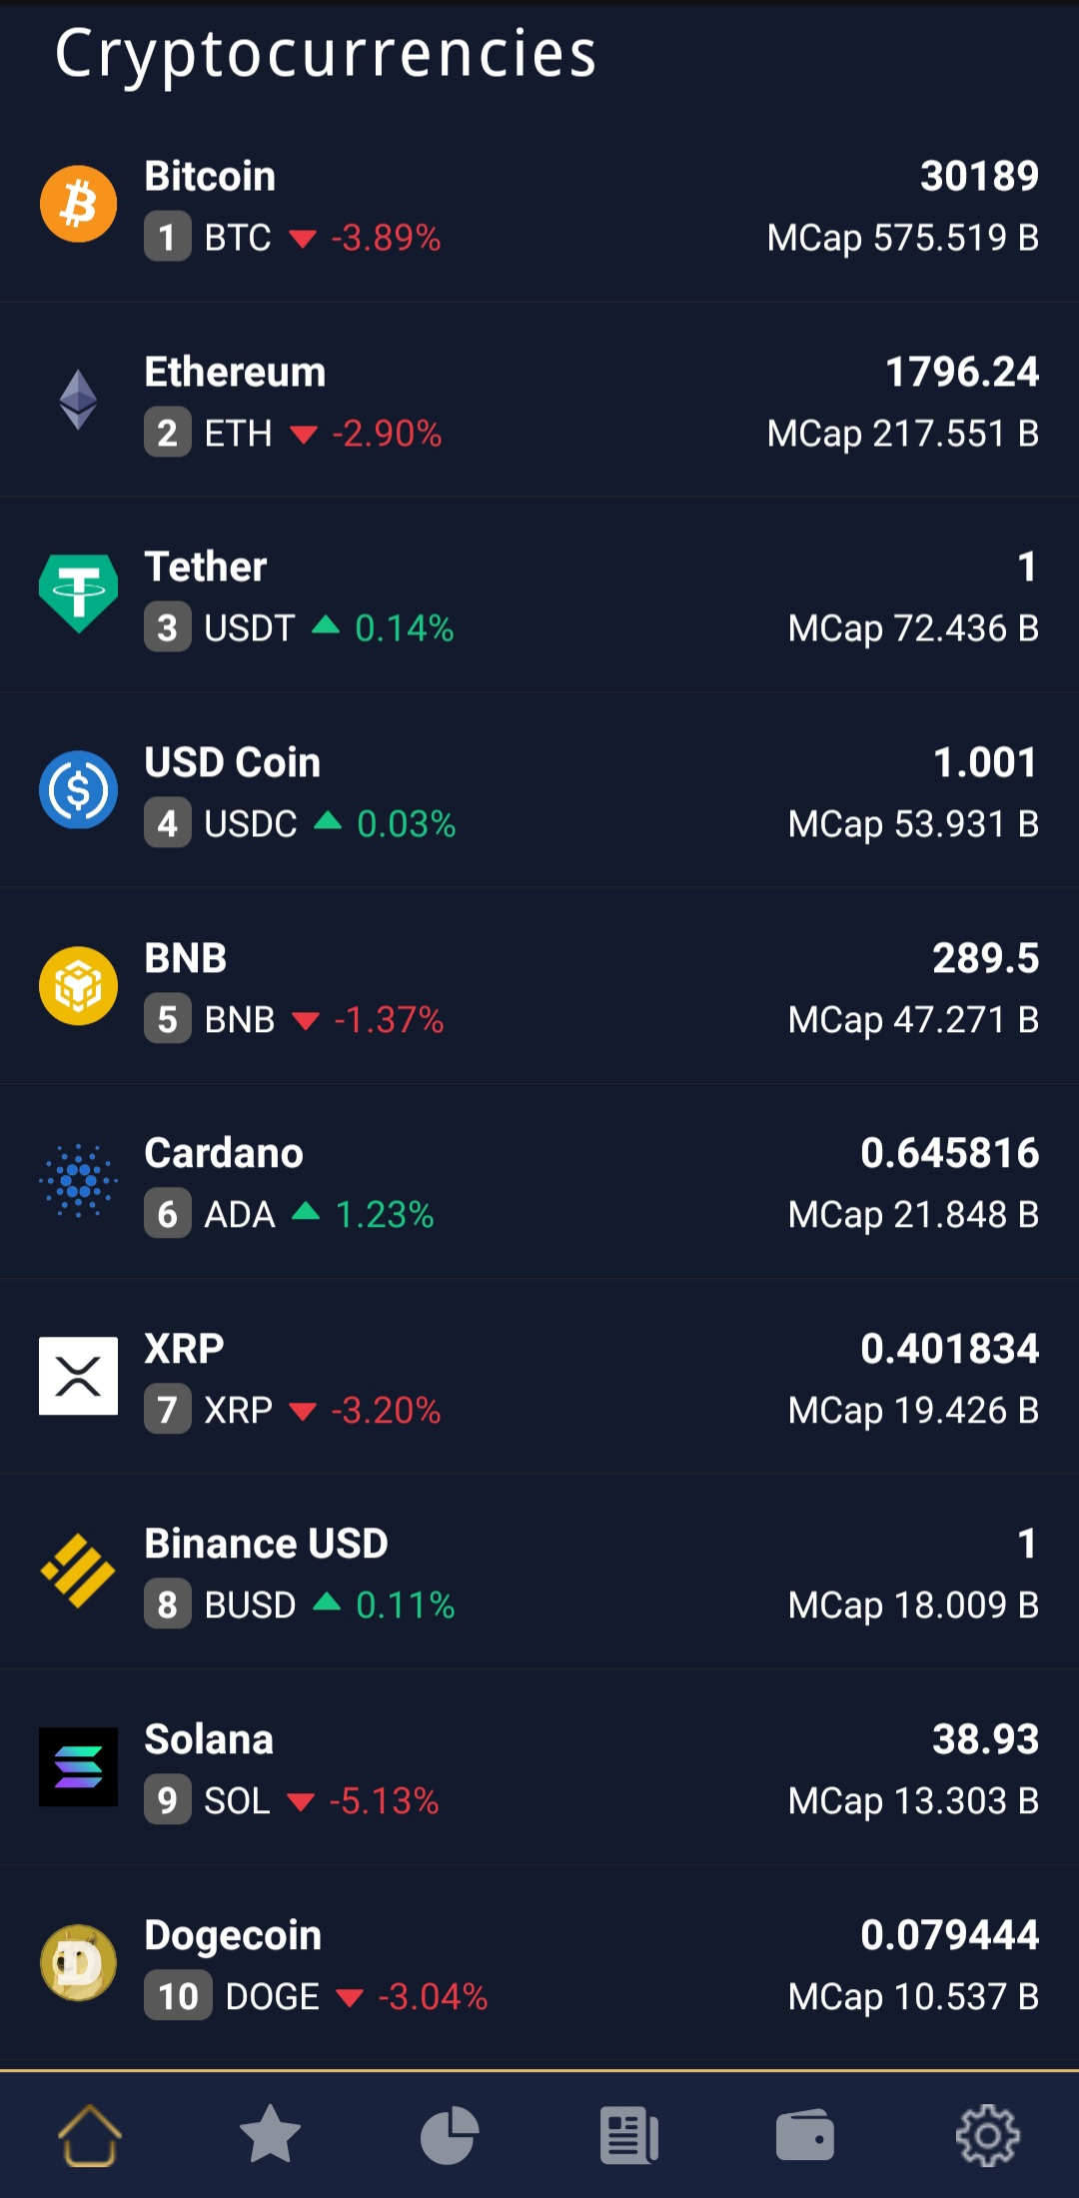
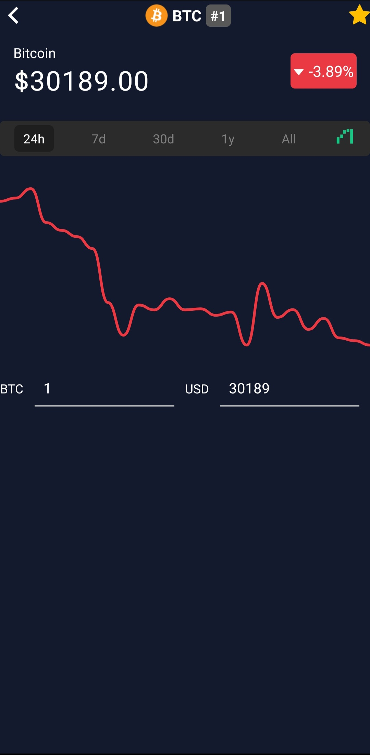
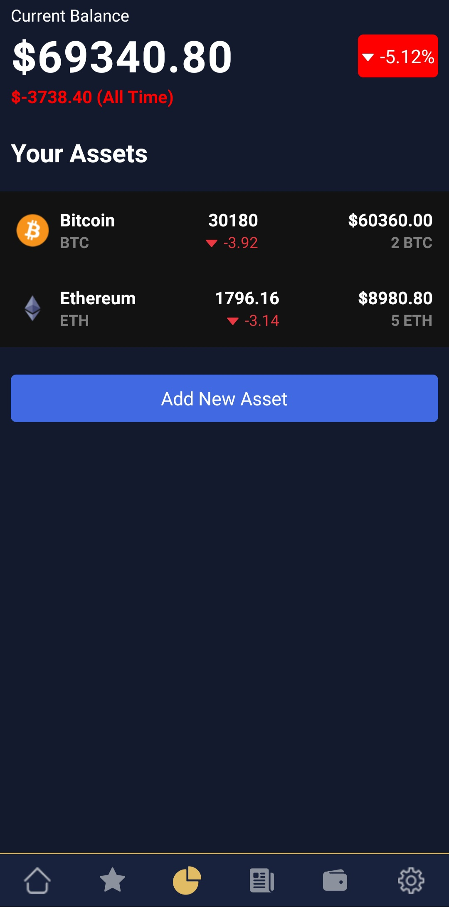
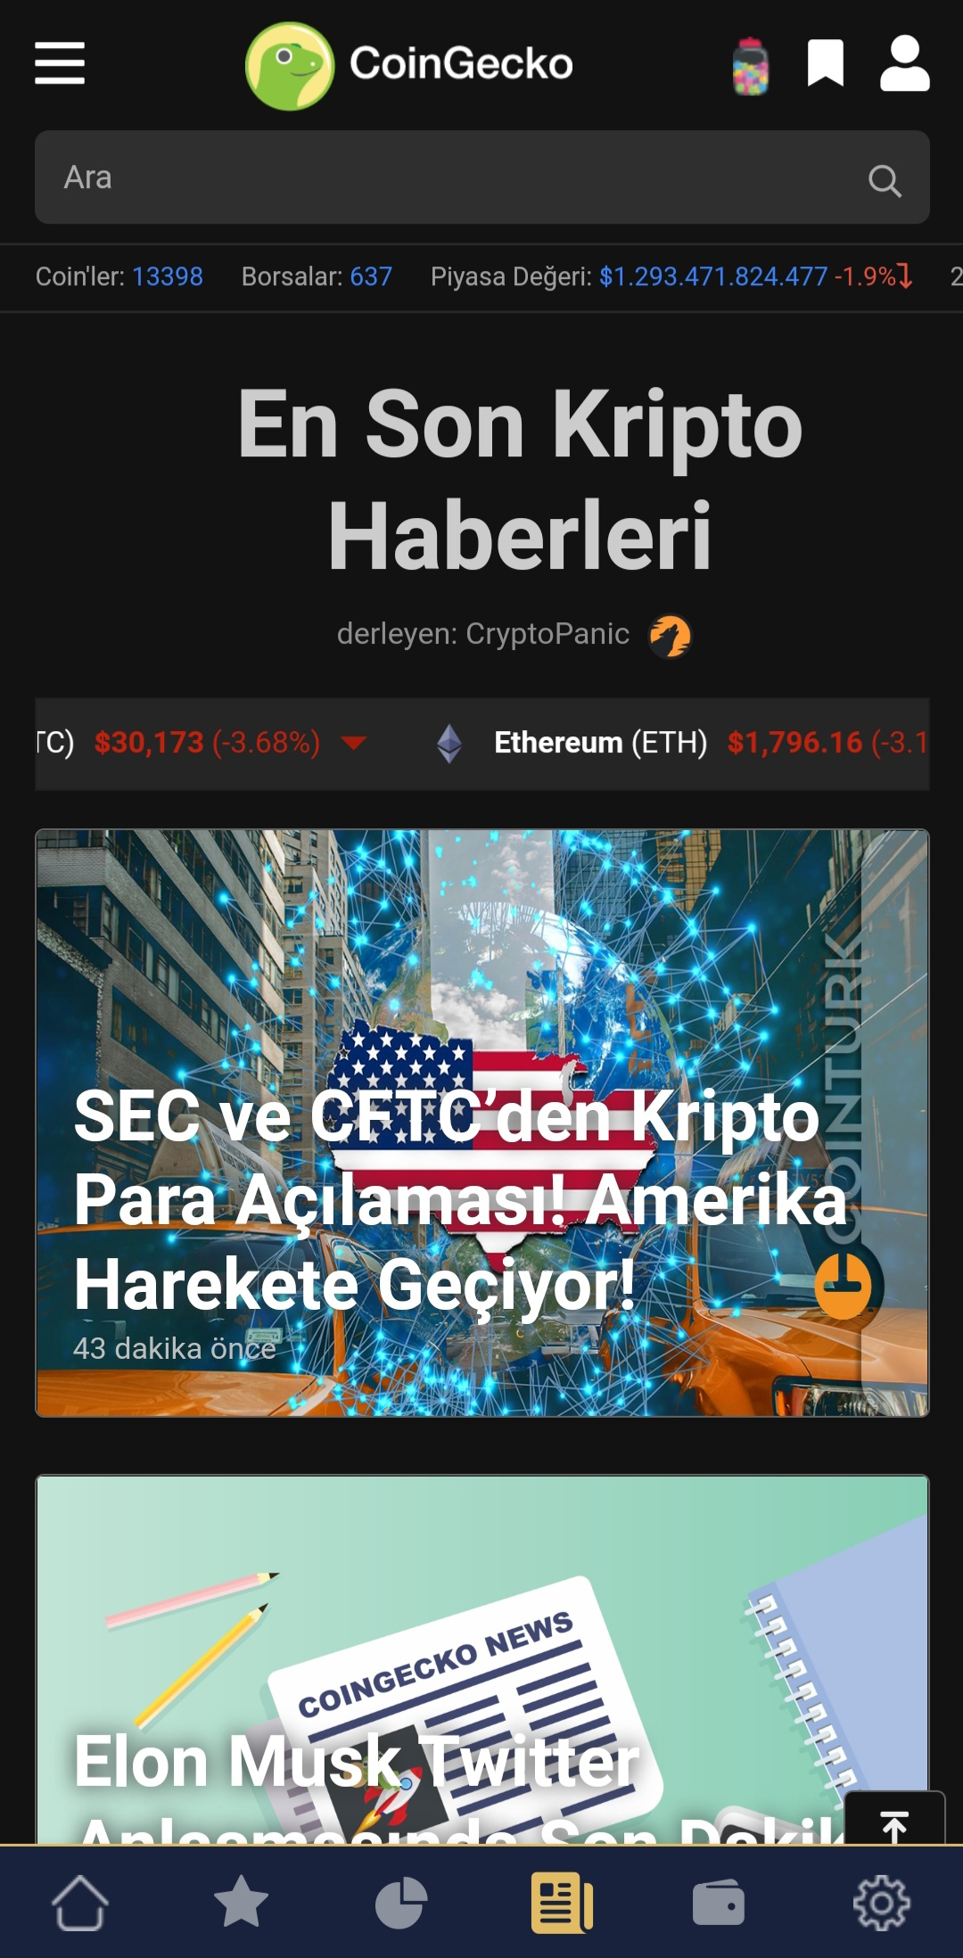
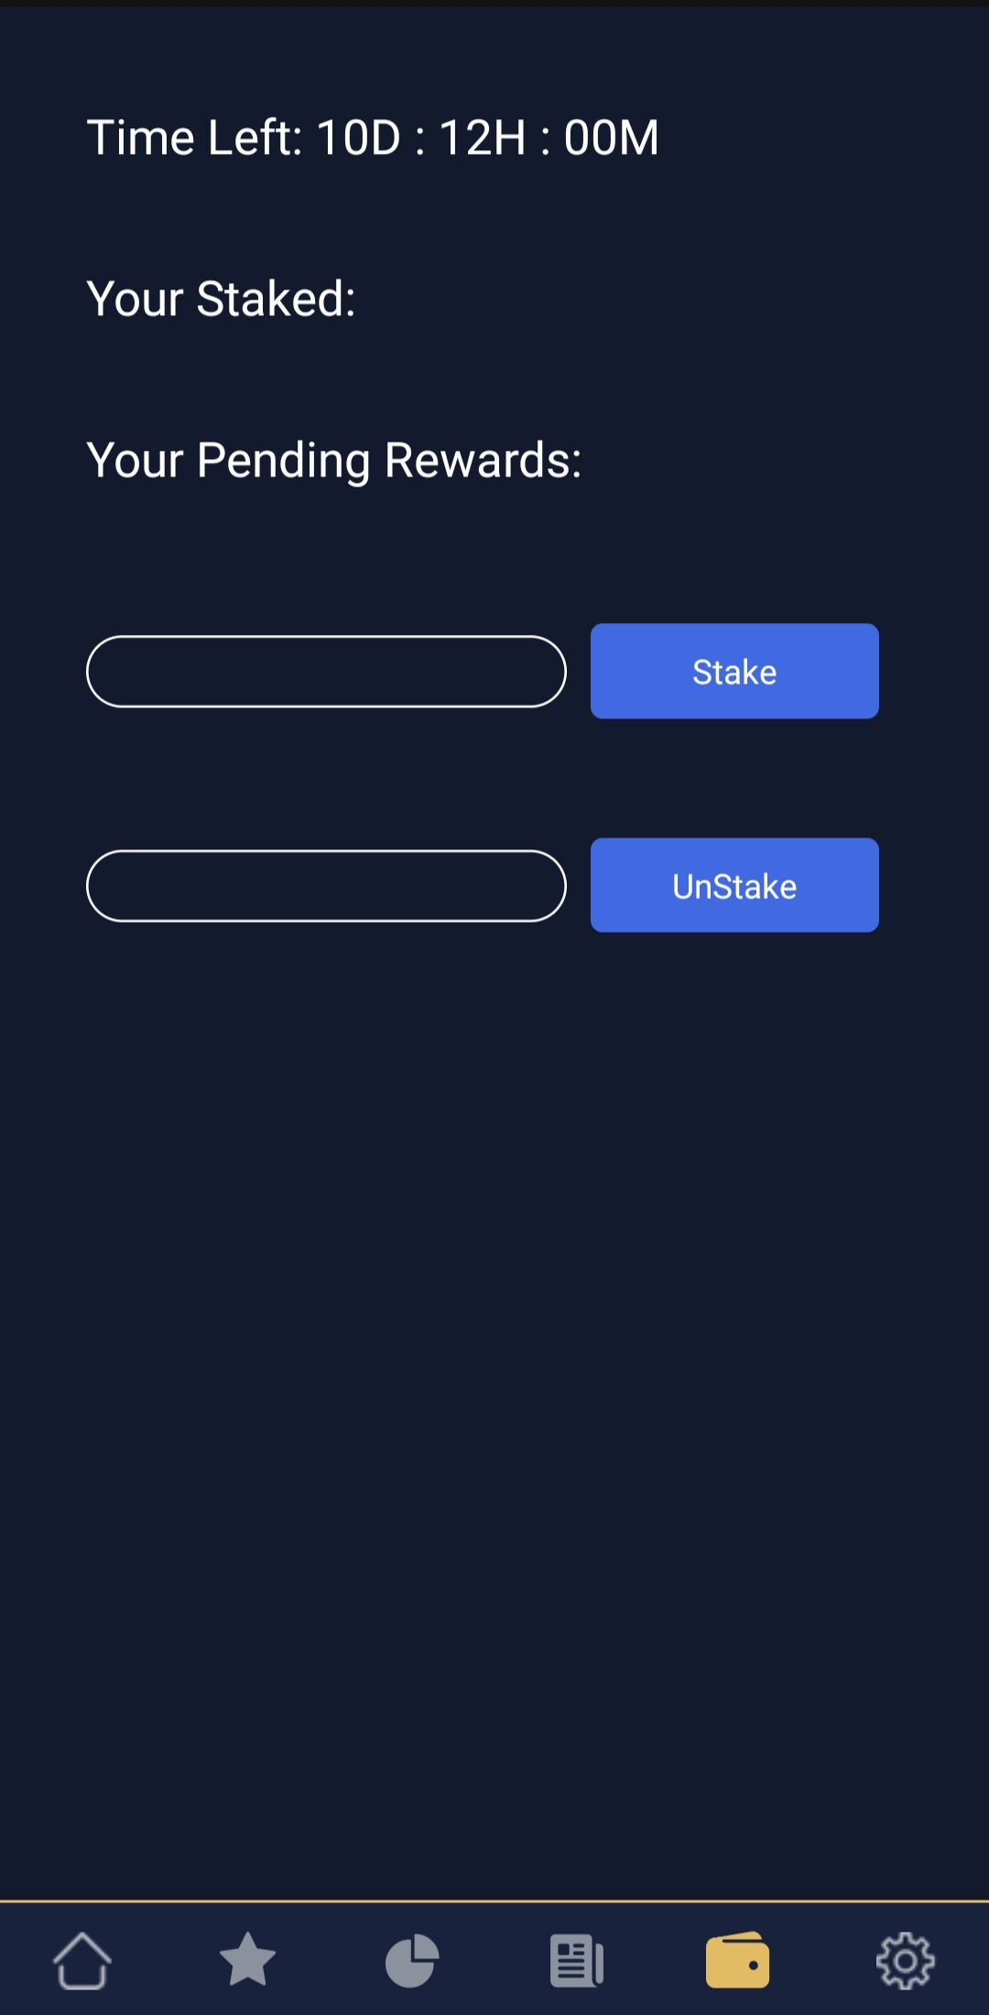
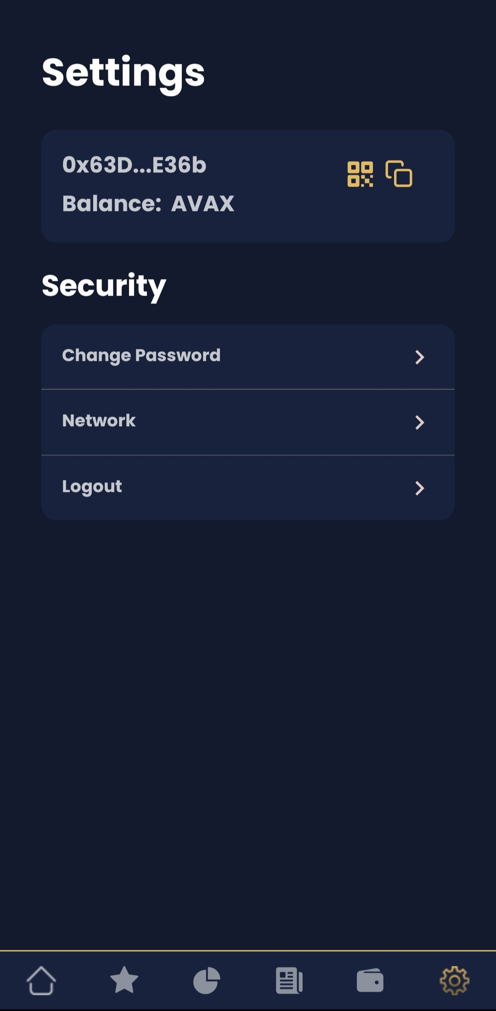
SUMMARY
Cryptocurrency Tracking and Staking Application
Software Engineering
2021-2022 Capstone Project
Tamer KÖŞE
RESULT & DISCUSSION
People would be able to instantly generate or import a wallet with only one tap.
Users will have the ability to add new assets or delete an existing one on their portfolio to track coin’s prices and their total balance.
Users will be able to follow the crypto news instantly.
Users can see the number of AVAX in their crypto wallet. They can switch between the main and testnets if they want.
To enable people to easily follow the coins they hold in different exchanges and crypto wallets, see the prices of the coins from a single place, get interest by staking and create a crypto wallet or import existing one securely. Follow the crypto news instantly.
The need for simple, user-friendly applications for people to keep track of coin prices and the coins they hold on different exchanges and crypto wallets.
Creating wallets on the Avalanche network can be complicated & cumbersome for end users and new users.
Accessing to the wallet is important for security, because any vulnerability could compromise the user's assets.
Most users need more flexible and customizable wallets with the latest blockchain technologies.
INTRODUCTION
Connecting user to the Avalanche blockchain in the fastest and most efficient way. Creating customizable interface where users can add new assets or interact them on their portfolio and easily tracking crypto prices on homepage.
Giving people the opportunity to increase their savings with staking.
Designing smooth and understandable interface for people who newly stepped in cryptocurrency world.
Follow the crypto news instantly.
RECOMMENDATIONS
To support multiple chains. (Ethereum, Binance Smart Chain etc.)
To fetch analytics of app usage.
To transfer coins via crypto wallet.
To send buy/sell orders to
Crypto Exchanges.
METHOD
One of the methods used for this purpose is to use a screen lock. For this, the user sets a password on their devices.
On the other hand, our second method is to be able to customize. For this purpose, users can search for the coins they want and learn the price, view the graph, add and remove them from their watch lists, and add and remove these coins to their portfolios. In their portfolio, they can learn their balances both in coins and in total.
In the application, users are able to create a crypto wallet or activate their wallets with a single button.
With the staking method, you can lock coins to the blockchain network for a certain period of time and increase the amount of coins in hand. With the Unstake method, the coin that was previously locked in the contract can be withdrawn to the wallet with the earned reward. (Planned but failed to interact with Reacct Native.)
Figure 1 - Welcome screen has two buttons which are creating wallet & importing wallet.
Figure 2 – Import an existing crypto wallet and set password for the app.
Figure 3 – Create a crypto wallet.Those words are secret phares generated randomly for your wallet.They should be stored carefully.
RESOURCES
Library that makes staking deposit,withdraw and claim functions: EatTheBlocks/staking and assafom/eatthestake
Allows writing smart contracts: Solidity
It interacts with the Ethereum Blockchain and its ecosystem: Ethers.js
Framework that is for developing mobile interfaces: React Native
Local device database for storing user’s password: SQLite
Similar project that is helpful for decentralized applications: ‎MetaMask
Visual Studio Code
Expo CLI
Figure 4 - Home screen has Rank,Market Cap,Prices&24H Changes of coins.We can go coin details when on click them.
Figure 5 – Looking coin’s details.We can see the price,line chart&time range.Top-left star is pressed,the coin will be added to watchlist.On long press on the chart,different times and their price on that time will be shown.
Figure 6 – Watchlist screen has the coins you give a star.You can track Rank,Market Cap,Prices&24H Changes of the coins.
Figure 7 – Portfolio screen that user can add new assets to track or delete,their prices,how much money each one has,total balance,24H changes on your portfolio.
Figure 8 – Current news for crypto
Figure 9 – Staking screen that allows user to stake or unstake the Project Coin.
Figure 10 Settings screen where user can see/copy their wallet address,learn AVAX balance,see QR of address,change password of the app,switch between AVAX mainnet&testnet and logout.

